Slide 1
Presentation on Plasma Display Panel (PDP)

Slide 2
Contents
Introduction
Short description of PDP
What is PDP
How it works
Circuit View
Application of PDP
General Charactertics
Advantages & Disadvantages
PDP vs. LCD vs. CRT

Slide 3
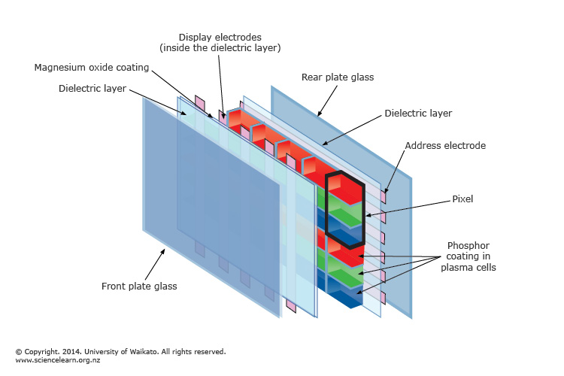
Introduction
A plasma display is a computer video display in which each pixel on the screen is illuminated by a tiny bit of plasma or charged gas, like a tiny neon light. Plasma displays are thinner than CRT displays and brighter than LCD. Plasma displays are sometimes called as “thin-panel.”
IBM built a plasma display in the 1980s .

Slide 4
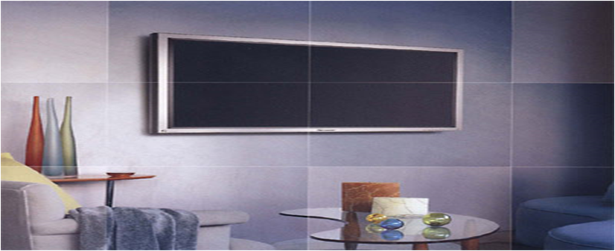
Plasma Display Panel (PDP)
A plasma display panel (PDP) is a type of flat panel display common to large TV displays 30 inches (76 cm) or larger.
Plasma display screens are made from glass, which reflects more light than the an LCD screen.

Slide 5
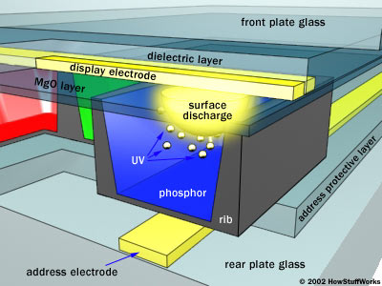
How PDP works
Millions of tiny cells in between in between two panels of glass
Noble gases & a minuscule amount of mercury gas or plasma.

Slide 6
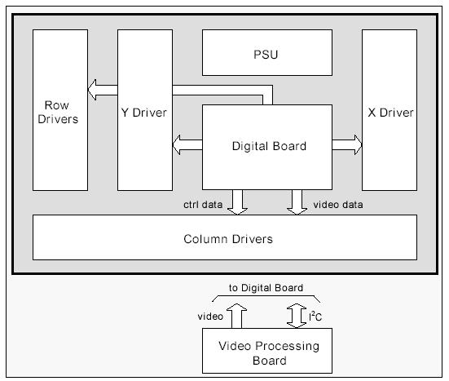
Circuit View

Slide 7
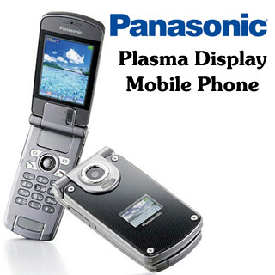
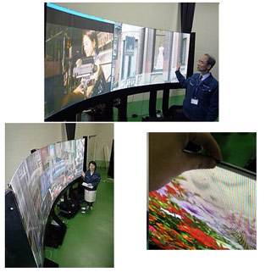
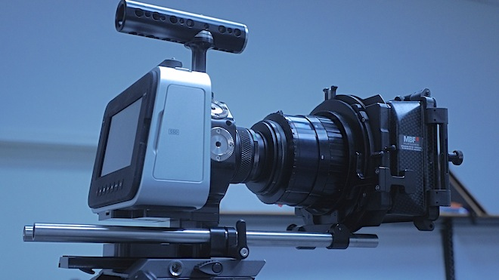
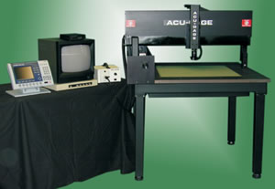
Applications of plasma display panels:

Slide 8
GENERAL CHARACTERISTICS
Plasma displays are bright (1,000 lux or higher for the module).
They have a wide color range.
The plasma display panel has a thickness of about 2.5 inches, which makes the total thickness not more than 4 inches.
For a 50 inch display, the power consumption increases from (50-400) watts in accordance with images having darker colours.
Very low-luminance “dark-room” black level.

Slide 9
Plasma TVs offer many advantages over other television technologies: Exceptional Color: Plasma TVs display up to 16.77 million colors. High Resolution: Plasma TVs are able to display a high resolution, and are capable of displaying HDTV signals. Widescreen Aspect Ratio: Plasma TVs offer a dramatic widescreen 16:9 ratio display. Flat Screens: Plasma TVs offer perfectly flat screens, cutting down on image distortion and glare.
ADVANTAGES

Slide 10
* Use more electrical power, on average, than an LCD TV. * Does not work well at high altitudes above 2 km due to pressure differential between the gases inside the screen and the air pressure at altitude. * It may cause a buzzing noise. For those who wish to listen to AM radio, or are amateur radio operators (hams) or shortwave listeners (SWL), the radio frequency interference (RFI) from these devices can be irritating or disabling.
DISADVANTAGES

Slide 11
PDP vs. LCD vs. CRT
Attribute | PDP | LCD | CRT
Size | 32”-63” | 10”-37” | <= 36” Distortion near edge
Peak brightness Level | Very good | Good | Best
Contrast ratio | Very good | Good | Best
Color fidelity | Excellent | Limited | Best
Dynamic Performance | Excellent | Poor | Best
Viewing angle | 160 degrees | 40-70 degrees | 160 degrees
Lifetime | Excellent (30,000 hrs) | Individual pixels can fail over time | Excellent

Slide 12


